Slide 1


Sprint 1 Week 2
Boom v5.0 Demos
pagekey.io

Slide 2
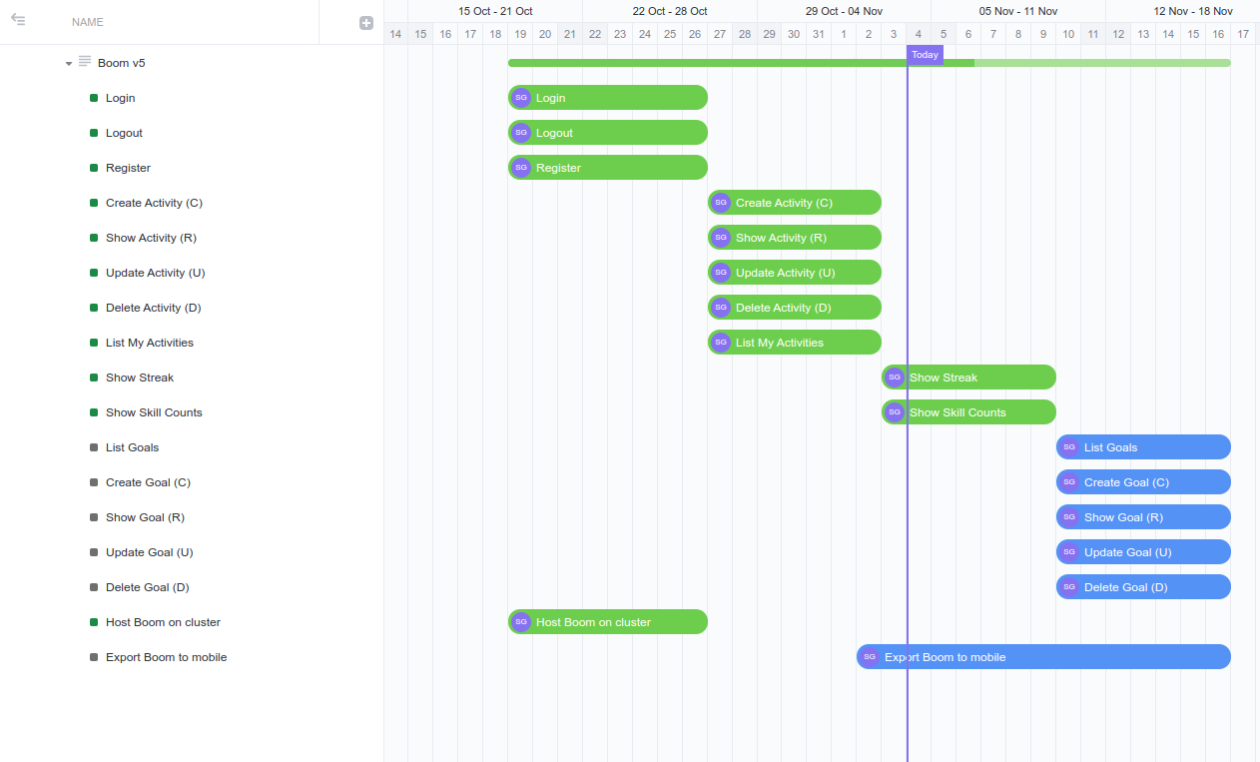

Slide 3
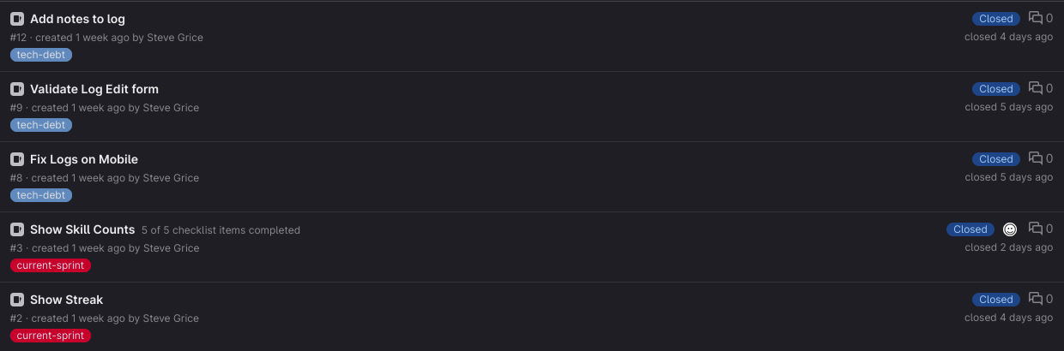
Closed Issues

Slide 4
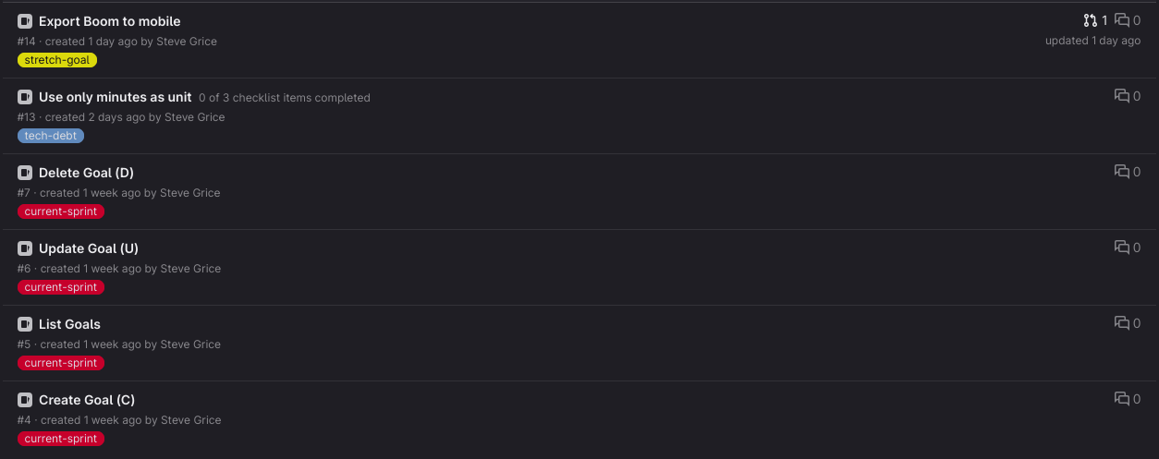
Upcoming Issues

Slide 5

Open Source?

Slide 6
Should I make Boom open source?
Could open source it, make a v2 later that is paid
Pro: Find a team who loves to work on it!
Pro: People can benefit from the work I've done so far
Pro: These devlogs can be more informative / dive deep into the code
Con: Easy for someone to copy what I have so far, pour resources in, and come up with a paid solution
Valid fear?
Thanks to Daron for great examples of open source projects that made it work
Node.js -> Same guy started Deno
Snipe.it

Slide 7

Reflection

Slide 8
Challenges
Continuing to work completely alone
Abandoning all other interesting projects
Staying consistent
Export to mobile

Slide 9

Successes / Progress
Closed out tech debt for logging
Added Streaks
Got more feedback / future feature ideas (Daron)

